Slide 1
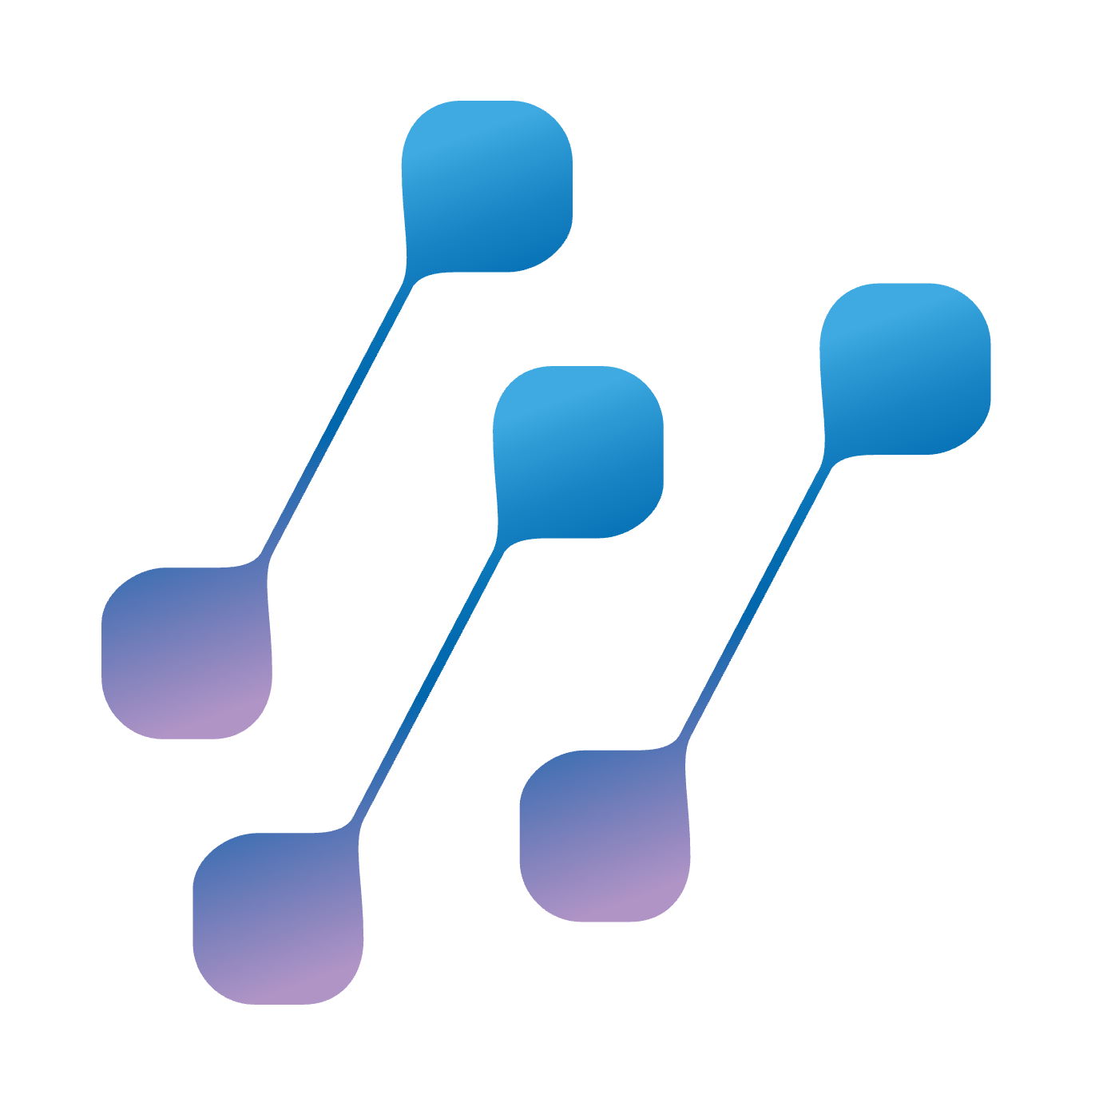
SCION: SECURE PATH-AWARE INTERNET ROUTING
Kevin Meynell, SCION Association <kme@scion.org>
MENOG 24, 1-5 December 2024

Slide 2
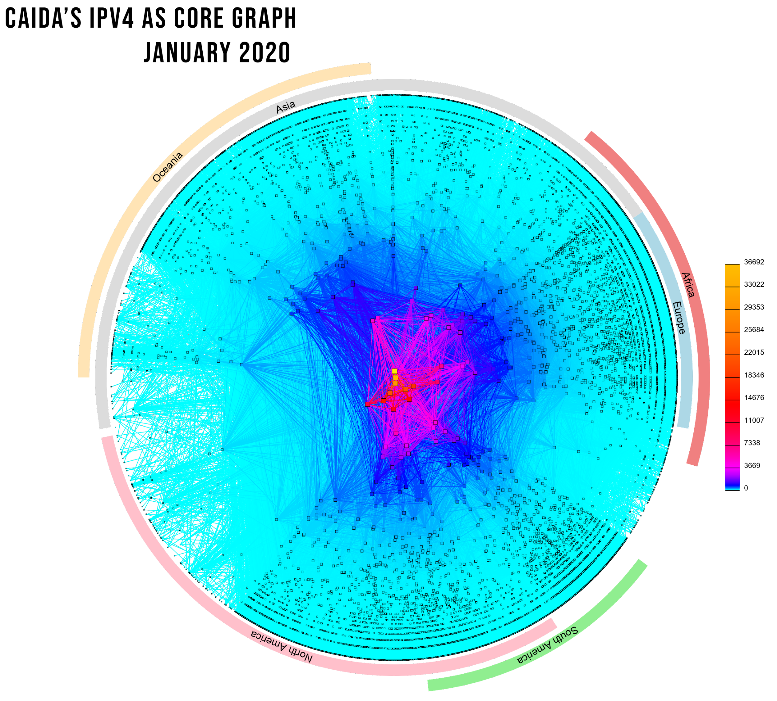
THE GLOBAL ROUTING SYSTEM
as of 1 December 2024
76,679 networks known as Autonomous Systems connected to the Internet, each using a unique Autonomous System Number (ASN) for identification
990,280 advertised IP prefixes (routes)
Many possible paths across the Internet

Slide 3

THE ROUTING PROBLEM
Border Gateway Protocol (BGP): the Internet routing protocol
The Border Gateway Protocol (BGP) used by the Internet routing system is inherently based on unverified trust between networks
No built-in validation that route advertisements are legitimate
Any network can announce any ASN or IP prefix
Any network can claim to be another network
Sending and receiving networks cannot decide the path that intermediate routers direct their traffic across the Internet

Slide 4
WHY IS THIS A PROBLEM?
Some info @ a glance
EVENT | EXPLANATION | REPERCUSSIONS | EXAMPLE
ROUTE LEAK | Usually accidental but sometimes malicious redirection of traffic through an unintended path. A network operator with multiple links announces to an upstream provider that it has a route to a destination through another link. | Traffic is delayed or never delivered, with the intermediate network(s) carries unintended traffic. Can be used for MITM including traffic inspection and/or modification. | In Jun 2019, Verizon accepted incorrect routes from DQE Communications that diverted traffic destined for Cloudflare, Facebook & Amazon through small ISP.
ROUTE OR PREFIX HIJACKING | A network operator or attacker impersonates another network operator by falsely announcing ownership of IP prefixes and/or ASNs. Re-routes traffic by offering a shorter or more specific path for malicious or censorship reasons. | Traffic is forwarded to the wrong destination. Can be used for Denial-of-Service attacks, traffic interception or network masquerading. | Feb 2022 – KLAYswap Cryptocurrency hijack Apr 2018 - Amazon Route 53 hijack Feb 2008 - YouTube hijack
DATA SOVEREIGNTY BREACHES | BGP routing can, and often does, send traffic across geopolitical boundaries. | Can breach national and supra-national (e.g. GDPR) data protection legislation. | May 2023 – Australian healthcare data transferred through another country.

Slide 5
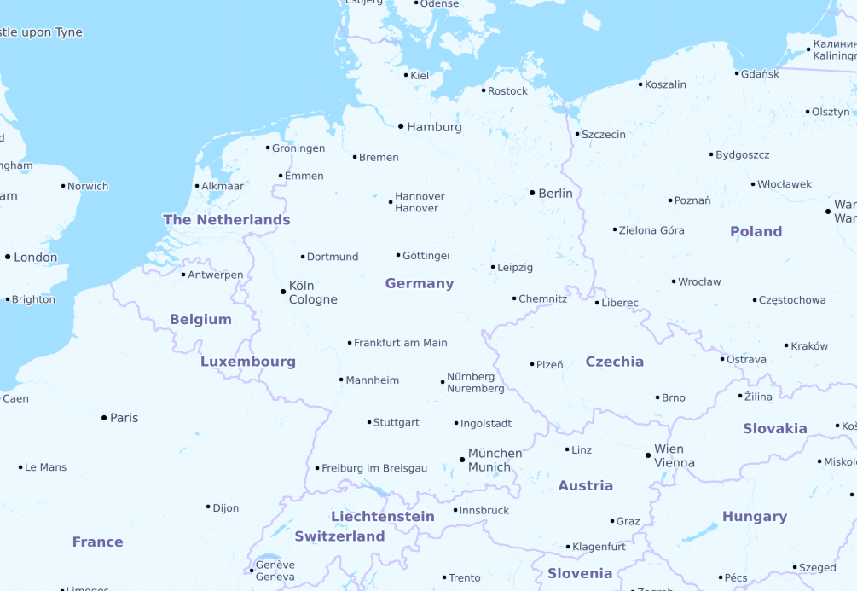


ROUTING PROBLEMS 101
Data sovereignty
Different countries have different regulations regarding transfer of sensitive data across geopolitical borders.
Routing can send traffic through different jurisdictions, thereby making regulatory compliance complex.

Slide 6
HOW IS THIS BEING ADDRESSED?
Some info @ a glance
EVENT | EXPLANATION | LIMITATIONS
RPKI & ROV Resource Public Key Infrastructure & Route Origin Validation | ROAs (Route Origin Authorisations) provide cryptographic assertions of IP prefix ownership and which ASNs are allowed to originate them. Routers can validate ROAs and generate appropriate route filters. | Requires widespread deployment to be effective (less than 50% of IP prefixes are signed in 2024) Few network operators currently use ROV (5%). Only does origin validation and does not validate paths through the Internet.
BGPSEC BGP Security | Builds on RPKI to provide cryptographic assertions that every router (hop) en-route to a destination has authorized the advertisement of that route. Prevents unauthorised insertion of ASNs into a path to circumvent RPKI. | Needs to be explicitly supported by all routers along a path to achieve full benefits. Computationally intensive and introduces significant delays in route convergence. Explicit path selection is not possible. Almost no deployment.
ASPA Autonomous System Provider Authorization | ASPA objects are similar to ROAs, but allow ASNs to authorize other ASNs to carry their traffic through the Internet. Works out-of-band so doesn’t need to be deployed on all routers. | Developmental stop-gap technology and not yet an Internet standard. Does not provide assurances that traffic will actually follow validated paths.
SCION | Inter-domain routing architecture offering secure path awareness and selection. | Needs to be supported by border routers.

Slide 7

CRITICAL INFRASTRUCTURE
Legacy infrastructure needs replacing
Example: Air Traffic Control
Many critical infrastructures in power, transport, emergency services etc.. run on legacy infrastructures
Many important legacy infrastructures are still not fully networked and/or are not IP based
It is expensive, inefficient and becoming harder to support these legacy infrastructures
The Internet is now able to provide sufficiently reliable and resilient connectivity, like the power grid
Critical infrastructure operators want to take advantage of commodity Internet services as they offer cost and resilience advantages, but higher trust and data sovereignty assurances are required
True inter-domain and multi-ISP support is highly desirable or required
Terminal Control Centers
Eurocontrol
Receives flight plans and assigns slots
Slots:
OLDI Protocol
P2P links
P2P
Phone
P2P
Area
Control
Centers
Flight Plans:
OLDI Protocol
and Phone
RADAR, ILS
Radio
Aircraft
Radio
Airport Tower & Apron
Airline Operational Control Centers
Star centered around Area Control Centers
Radar & ILS physically connected to control towers
No connectivity between Control Centers beyond phone
Aircraft can only be managed within radio range of Control Center (so cannot be slowed/speed-up by destination)
OLDI protocol is based on data layer similar to RS232
Aircraft transponders can be spoofed and jammed
Limited coordination means inefficient management of slots
System heavily reliant on closed loop and implicit trust

Slide 8







WHAT IS SCION?
SCION is an inter-domain path-aware architecture
Office
IoT
INTER-DOMAIN MULTIPATH ROUTING:
Fast path failover (can switch to backup path in ~RTT)
Multi-operator
PATH CONTROL:
Source endpoints can select AS path (included in packet header)
PATHS ARE AUTHENTICATED AT DISCOVERY
AND VERIFIED AT FORWARDING:
Higher assurance that packets will follow certain path
Hijacking prevention
Geofencing
Cloud
Home
office
Internet-based secure and reliable communication for critical infrastructure ecosystems (e.g. financial services, power utilities, emergency services, government, …)
Data center
Bank

Slide 9
TRUST-ENHANCED NETWORKING
Trust model is based on Isolation Domains (ISDs)
  An ISD is a logical grouping of ASes sharing a uniform trust environment (e.g. a common jurisdiction).
  Each ISD is administered by one or more ASes via a voting mechanism. These are known as core ASes and form the ISD core.
  Every ISD has its own trust root specified in the Trust Root Configuration (a collection of X.509 certificates with ISD information)
  TRC is negotiated by the ISD core according to its own trust policy.
  Not reliant on third-party CAs.
  The CAs in an ISD can only create certificates for ASes in their respective ISD.
TRC
0
Core
I
J
A
B
Core
Core
K
M
L
C
E
D
N
P
O
F
H
G
Q
S
R
TRC
TRC
ISD is the main building block of SCION
Notes:
The building block of SCION

Slide 10
HOW IT WORKS
SCION core components in a nutshell
CONTROL PLANE - BEACONING
Establishes paths based on AS rather than prefixes
Beacon server uses path segment construction beacons (PCBs) to build path segments and routing paths
Path server stores paths to AS discovered during beaconing
Endpoints combine path segments to form end-to-end paths
PKI authenticates path information
Isolation Domain (ISD):
Grouping of Autonomous Systems (AS)
Each ISD has its own trust root
Isolates AS control planes and reduces communications overhead
ISD
0
Core
I
J
A
B
Core
Core
K
M
L
C
E
D
N
P
O
DATA PLANE – PACKET FORWARDING
Combine path segments into end-to-end path (ISD-AS level)
SCION packets contain end-to-end ISD-AS path
Border routers forward SCION packets to next SCION router or end destination based on end-to-end path
F
H
Packet P1
G
Q
S
F➔C➔A
R
A➔I➔J➔M
AS
M➔P➔S
ISD
ISD
Payload
Packet from AS F to AS S

Slide 11
DEPLOYMENT MODEL
SCION ROUTERS
SCION AS
SCION routers are set up at the borders of an AS
Border routers peer with other SCION-enabled networks and collect customer traffic
Control services discover, map and validate network paths
No change to the internal network infrastructure needed
Endpoints run a SCION stack
Legacy endpoints can use SCION gateways
C
CONTROL SERVICES (PER AS)
AS
Beacon server – propagates and receives PCBs to construct path segments and routing paths
Path server – store mappings of AS to path discovered during beaconing
Certificate server – caches copies of TRCs and AS certificates and key management for inter-AS comms
C
Control Services
Border router
Internal router

Slide 12
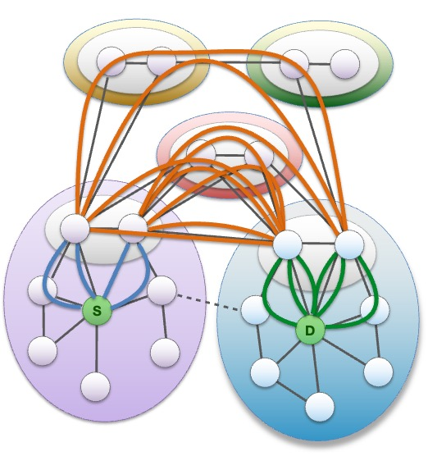
SCION BENEFITS: FAST MULTI-PATH DISCOVERY & FAILOVER
Advantages over regular Internet
BGP generally selects routes based on ‘lowest cost’ regardless of whether these are in practice the most optimal or they meet particular requirements.
With SCION, Leaf ASes only receive and do not forward any beacons. Only core ASes initiate beacons.
Beaconing does not rely on iterative convergence nor forwarding table updates, allowing rapid path exploration within ISDs.
The control services discover path segments and assemble these into available paths.
Tests show path failover to be within 1-2 seconds.
Applications can choose paths based on optimal characteristics or other parameters, and can also use multiple paths simultaneously.

Slide 13
FACTS ABOUT SCION
Dispelling the Myths
SCION works with the existing Internet, but aims to address some of the shortcomings of BGP for particular users.
SCION introduces the concept of trusted ASes and provides greater assurances about inter-domain path security, whilst offering interoperability with the wider Internet as required.
Is SCION trying to replace the Internet?
SCION is already deployed and actively used in production networks including SSFN, SSHN & SCIERA (which is used by research and education networks).
SCION has commercial and open source implementations.
The SCION specification is being documented at the IETF.
Is SCION just an experimental technology for researchers?
SCION is actively being evaluated by the financial, healthcare, power utility, government, defence, aviation and rail sectors, and is also being considered for time distribution networks.
Several ISPs and IXPs are considering deployment.
What are the main use cases for SCION?

Slide 14
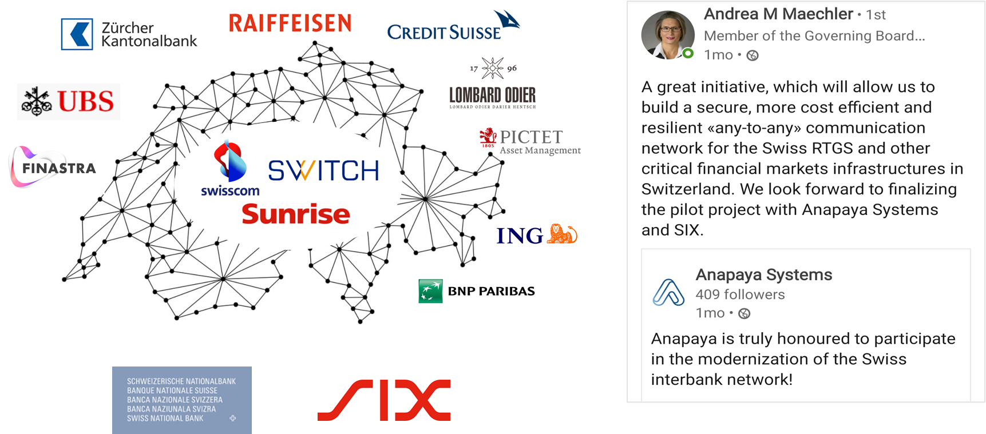


REAL-WORLD DEPLOYMENT:
THE SECURE SWISS FINANCE NETWORK
Swiss inter-banking network, handling money transfers between banks and other critical real-time financial services, operated by SIX, the Swiss Financial Infrastructure operator.
Reasons for using SCION:
Enforceable governance thanks to SCION’s trust concept
Performance-based routing & fast failover
Geofencing
Multi-ISP
SOME FACTS:
300+ finance institutions
Network handling ~200 Billion CHF/day
Migration to SCION-based SSFN ongoing until September 2024
https://www.six-group.com/en/products-services/banking-services/ssfn.html

Slide 15
SSFN DEPLOYMENT EXPERIENCES
WHY WAS SCION ADOPTED?
LESSONS LEARNED
SIX clients previously used Finance IPNet or point-to-point connections. Finance IPNet was reaching end-of-life.
IPNet did not limit connections to the rest of the Internet (e.g. no route controls) and offered limited protection against cyber risks.
Point-to-point connections lacked flexibility and had single points of failure.
Lacked strong governance and geofencing.
Establishment of an ISD requires the creation of admission criteria, process documentation, and legal agreements.
Initial establishment of ISDs requires key-signing ceremony involving voting ASes.
Manual checks are needed when onboarding candidate ASes to ensure they meet admission criteria.
Building the PKI and management integration of the services was challenging (although SSFN offers managed service).
Certificate revocation not possible, although they expire within 72 hours.
SCION products are still relatively new and not all features are implemented yet.
Inter-ISD path control is currently limited.
The community and sources of expertise are currently limited.
Practical experience has been that path failover and fallback occurs within a few seconds.

Slide 16
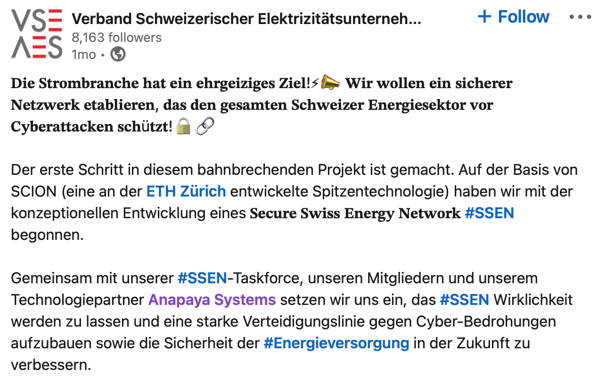






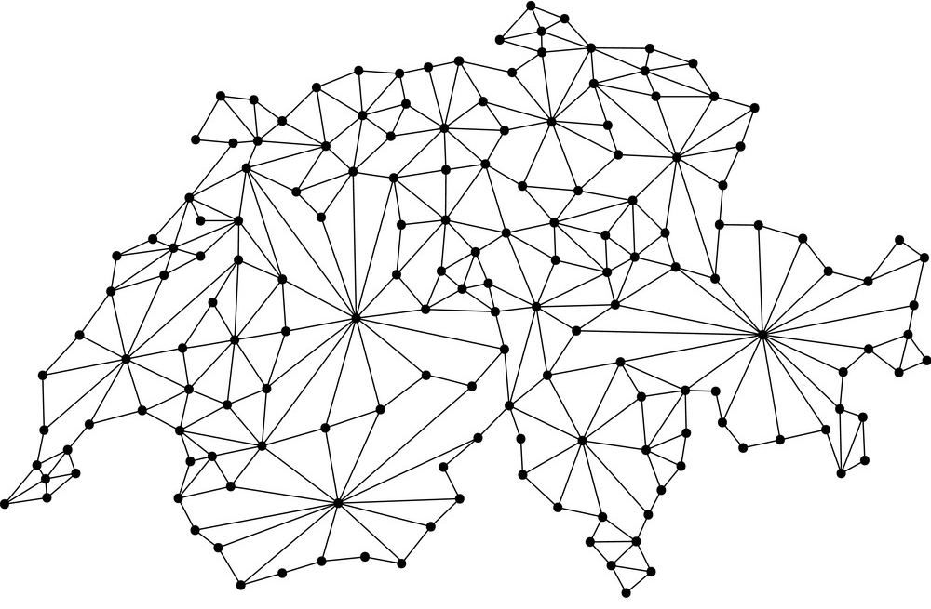















DEPLOYMENT BEYOND FINANCE
HEALTHCARE
EDUCATION
POWER
The HIN Trust Circle adopts SCION to interconnect hundreds of hospitals and thousands of doctors.
The SCION Education, Research & Academic Network connects campuses with path-aware high performance SCION connectivity.
The Association of Swiss Electricity Companies is exploring SCION to connect electricity market players.
Hospitals
Pharmacies
Labs
Doctors
Rescue
Insurances
Administration
Patients

Slide 17


IXP DEPLOYMENT:
SwissIX
SwissIX is first IXP to offer native SCION interconnection
Why should IXPs support SCION?
SSFN has already deployed SCION and other European financial networks are considering deployment
Many legacy critical infrastructures are due for replacement in coming years
Trusted domains and path security is important in many sectors
National critical infrastructures require secure inter-operation
IXPs are key components in the critical infrastructure landscape
Supporting SCION will encourage deployment
https://www.swissix.ch/services/scion-peering-mesh/

Slide 18
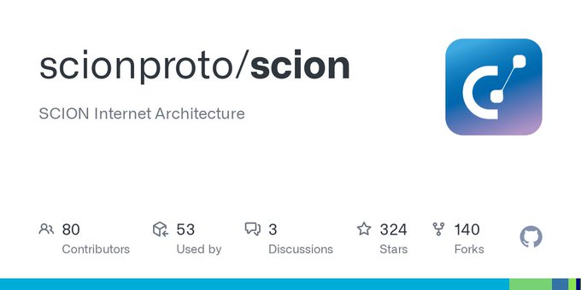

COMMERCIAL & OPEN-SOURCE IMPLEMENTATIONS
If you’re interested in deploying SCION, there are currently two options:
Commercial
Open Source
Other implementations under development: P4, Rust, OpenWRT
SCION Association formed by deployers and early adopters to support open source development, standardization, and community involvement.

Slide 19
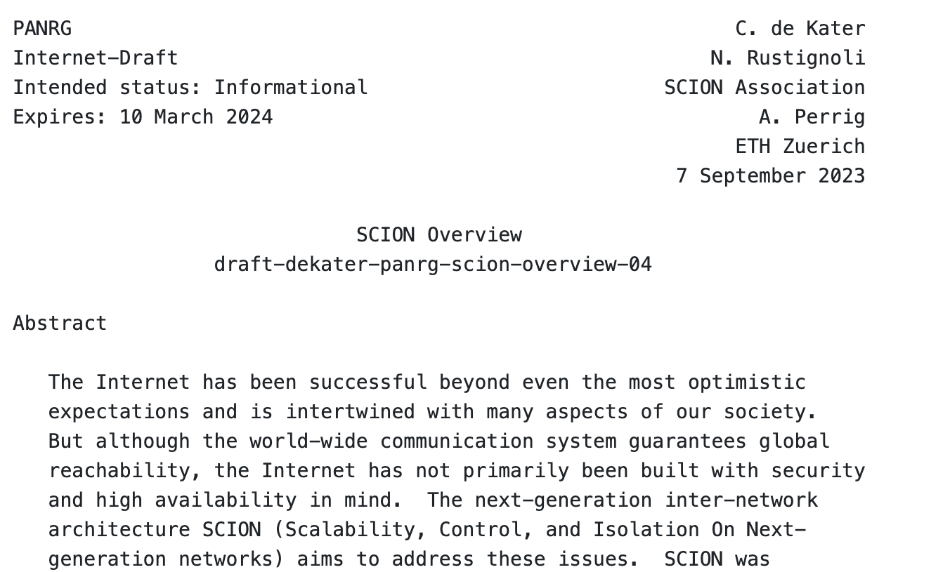
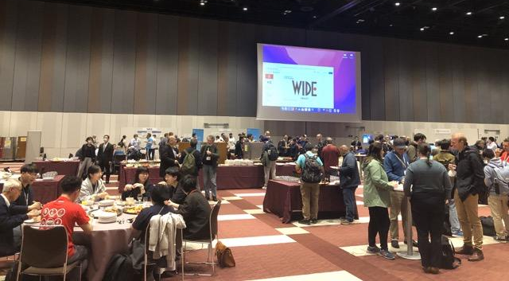
INTERNET ENGINEERING
TASK FORCE
Open specifications are important for interoperability and to encourage other implementations
SCION components and functionality currently being documented through PANRG (an IRTF Working Group)
Discussions with other IETF Working Groups
Independent Submission Stream
Hackathon @ IETF 118: Control Plane RPC over HTTP/3
Current Internet Drafts:
SCION PKI draft-dekater-scion-pki
SCION Control Plane draft-dekater-scion-controlplane
SCION Data Plane draft-dekater-scion-dataplane
SCION Deployment Issues In development…
SCION Research Questions In development…

Slide 20
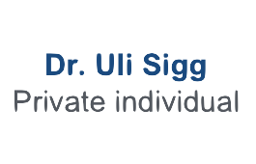



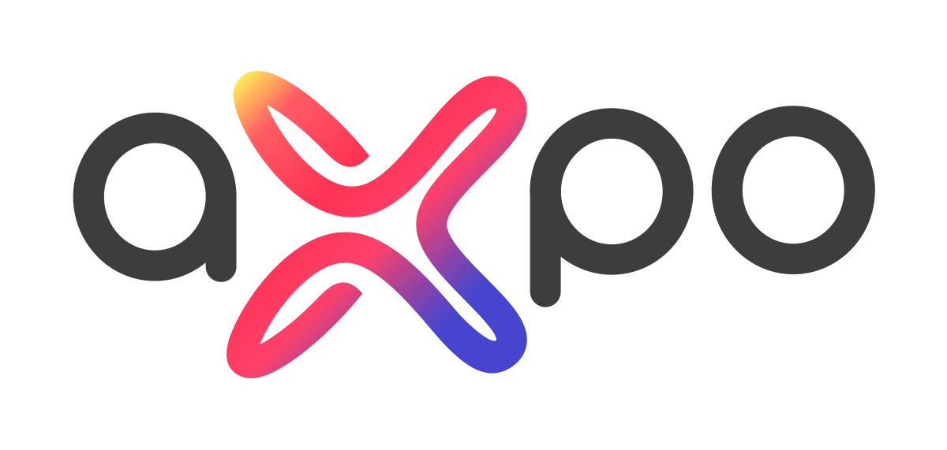
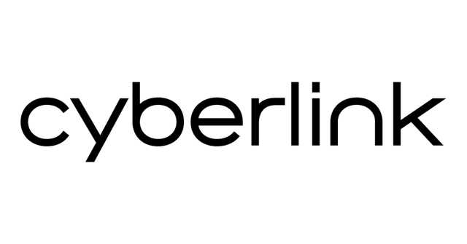




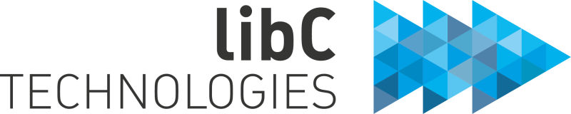

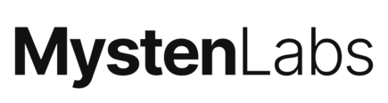

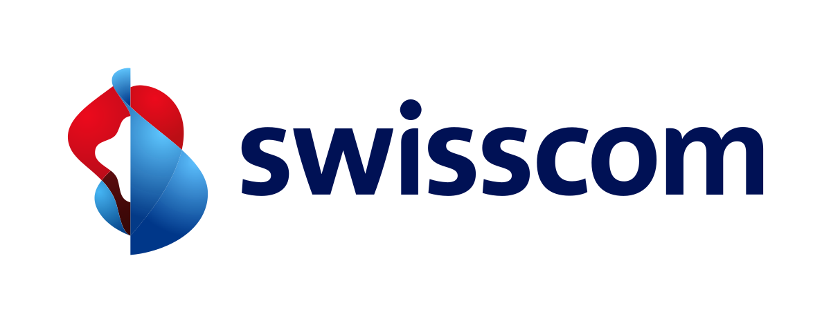





THE SCION ASSOCIATION
Promoting openness and collaboration to unlock the full potential of SCION
Non-profit association established in 2022
Open for membership to all entities interested in SCION
https://www.scion.org
COMMUNITY
Raising awareness of SCION, promoting the benefits and encouraging adoption, developing its community, and providing marketing support to implementors and deployers
STANDARDIZATION
Developing the specifications to implement SCION, with the goal of making it an interoperable Internet standard
OPEN SOURCE
Maintaining and coordinating the SCION implementation for research, development, and experimental deployments

Slide 21

THANK YOU!
More information:
SCION Association: https://www.scion.org
Reference & Developer Docs: https://docs.scion.org/
Research: https://scion-architecture.net
Vendor: https://www.anapaya.net/resources
Latest Release: https://github.com/scionproto/scion/releases/
The Complete Guide to SCION
Springer Verlag, 2022

